Slide 1
Week 1 diary, essay, memoir, narrative
Travel writing
Lesley Klenk, Ph.D.
South Sound Senior Services
Spring 2020

Slide 2
Welcome and Introductions
How experienced are you with Zoom?
What is your preferred mode for writing? By hand? All on computer? Save to hard drive, jump drive or the cloud?
Do you blog?
Do you write to publish?
Do you write just for yourself?
What “slice of time” did you write about in your assignment?

Slide 3
Our journey will include:
Study the travel writing of authors
Practice, experience, stretch, hone and complete our own writing
Develop understanding and implementation of theme.
Use dialogue to move your writing, make it authentic, and make your location real.
Drip or douse your writing with humor to convey to your reader the joy of traveling
Use sensory description to add depth and roundness to your writing
Try the stylistic devices of excursion and digression to intentionally direct your reader to the importance of person and place
Develop a delightful voice thar marks your writing as your own

Slide 4
Questions to Guide Our Travels…
What is travel writing?
Who is a travel writer?
What is the purpose of travel writing?
Who is the audience for travel writing?
What are the modes for travel writing?

Slide 5
Travel writing as a grab bag of genres, styles, and voices
The travel book itself has a similar grab bag quality. It incorporates the characters and plot line of a novel, the descriptive power of poetry, the substance of a history lesson, the discursiveness of an essay, and the—often inadvertent—self-revelation of a memoir. It revels in the particular while occasionally illuminating the universal. It colors and shapes and fills in gaps. Because it results from displacement, it is frequently funny. It takes readers for a spin (and shows them, usually, how lucky they are). It humanizes the alien. More often than not it celebrates the unsung. It uncovers truths that are stranger than fiction. It gives eyewitness proof of life’s infinite possibilities.“
–Thomas Swick, "Not a Tourist." The Wilson Quarterly, Winter 2010

Slide 6
Inspiration for the title and description of our travel writing class
Jonathan Raban describes the travel book as ''a notoriously raffish open house where very different genres are likely to end up in the same bed. It accommodates the private diary, the essay, the short story, the prose poem, the rough note and polished table talk with indiscriminate hospitality. It freely mixes narrative and discursive writing.‘’
And that freedom, that heterogeneity, has always been one of its charms -- the freedom to slip and slide between autobiography. As a good trip provides moments in which to linger and reflect, so the travel writing at its best enjoys the liberty to wander, to muse and to let the writer's enthusiasms explode; even, perhaps, to stop for a while and put down roots.

Slide 7
Thoreau stayed home…
"It's not worthwhile to go around the world to count the cats in Zanzibar.“
-- HENRY DAVID THOREAU

Slide 8
Create places…we can always find locations on a map
A location can be found on a map. It is singular in name and geography. It feels limited, fact-oriented, and we can’t change it.
Place is open and borderless. It includes weather, housing, transportation and the writer’s interpretation of all of it.

Slide 9
The Four Modes of Travel Writing
The Diary: intensely personal, meant for a single reader (the writer), does not need to adhere to rules of writing, completeness of content, or description of physical space
The Essay: has an intent, purpose, (perhaps didactic) responsibility to portray the physical landscape in such a way that it reflects the overall subject of the essay. The writer has a “role”—journalist, advocate, judge. The voice may feel academic, and arriving at a theme and/or realization is not necessary
The Memoir: first person voice, feels personal and direct may be present tense or past tense, it is always told through the lens of the writer, excursions and digressions examples are chosen to fit the purpose—understand—and believe--the message of the writer
The Narrative: walks the line between fiction and non-fiction, it features a story structure, with less description but more action, and narration, emphasis on “characters” and events

Slide 10
The Travel Diary…(sometimes a letter or two)
“People who keep journals have life twice,” said author Jessamyn West
“Never discriminate, never omit” is one of the unstated rules of diary-keeping. The rule is perverse, because all writing is about control, and writing a diary is a way to control the day—to have, as it were, the last word.
In a diary, the trivial and inconsequential—the “woke up, got out of bed, dragged a comb across my head” pieces—are not trivial and inconsequential at all; they are defining features of the genre.
For a diarist, if nothing important happened, it’s extremely important to say so a diary is about discovering, recording, observing, A diary has one audience, the writer. Internalizes and comments. Always about a struggle known and unknown.

Slide 11
Captain Scott’s Diary for the 1912 Failed Journey to the South Pole
Friday, March 16 or Saturday 17 - Lost track of dates, but think the last correct. Tragedy all along the line. At lunch, the day before yesterday, poor Titus Oates said he couldn't go on; he proposed we should leave him in his sleeping-bag. That we could not do, and we induced him to come on, on the afternoon march. In spite of its awful nature for him he struggled on and we made a few miles. At night he was worse and we knew the end had come.
Should this be found I want these facts recorded. Oates' last thoughts were of his Mother, but immediately before he took pride in thinking that his regiment would be pleased with the bold way in which he met his death. We can testify to his bravery. He has borne intense suffering for weeks without complaint, and to the very last was able and willing to discuss outside subjects. He did not - would not - give up hope till the very end. He was a brave soul. This was the end. He slept through the night before last, hoping not to wake; but he woke in the morning - yesterday. It was blowing a blizzard. He said, 'I am just going outside and may be some time.' He went out into the blizzard and we have not seen him since.
Wednesday, March 21 - Got within 11 miles of depot Monday night; had to lay up all yesterday in severe blizzard. To-day forlorn hope, Wilson and Bowers going to depot for fuel.
Thursday, March 22 and 23 - Blizzard bad as ever - Wilson and Bowers unable to start - to-morrow last chance - no fuel and only one or two of food left - must be near the end. Have decided it shall be natural - we shall march for the depot with or without our effects and die in our tracks.
Thursday, March 29 - Since the 21st we have had a continuous gale from W.S.W. and S.W. We had fuel to make two cups of tea apiece and bare food for two days on the 20th. Every day we have been ready to start for our depot 11 miles away, but outside the door of the tent it remains a scene of whirling drift. I do not think we can hope for any better things now. We shall stick it out to the end, but we are getting weaker, of course, and the end cannot be far. It seems a pity, but I do not think I can write more.
For God's sake look after our people."

Slide 12
Elements of the Travel Essay
Purposes can be to entertain, instruct, inform, explain, advocate, judge
Should purposefully select and include local customs, traditions, places of interest, local history, and culture to fit the determined audience
Include examples that illustrate “place”: harrowing adventures, meet and greet with locals, provide prices, transportation options, “not to be missed” excursions and entertainment
Writer’s role is determined (see purposes)
Reader matches purpose and writer
Place is unforgettable in descriptions

Slide 13
Edward Abbey’s Essay on Desert Solitude
…In the first place you can’t see anything from a car; you’ve got to get out of the goddamned contraption and walk, better yet crawl, on hands and knees, over the sandstone and through the thornbush and cactus. When traces of blood begin to mark your trail, you’ll begin to see something, maybe. Probably not. In the second place, most of what I write about in this book is already gone or is going under face. This is not a travel guide but an elegy. A memorial. You’re holding a tombstone in your hands. A bloody rock. Don’t drop it on your foot—throw it at something big and glassy. What do you have to lose?
…These are natural arches, holes in the rock, windows in stone, no two alike, as varied in form as in dimension … formed through hundreds of thousands of years by the weathering of the huge sandstone walls, or fins, in which they are found. Not the work of a cosmic hand, nor sculptured by sand-bearing winds, as many people prefer to believe, the arches came into being and continue to come into being through the modest wedging action of rainwater, melting snow, frost, and ice, aided by gravity…

Slide 14
Elements of the Travel Memoir, also known as the Travelogue
Writer carefully selects events and subjects that support the intent of revealing memories and making meaning
Everything is described all told through a narrow and deep eye
First person voice feels personal and direct may be present tense or past tense
The Writer uses both internal dialogue and direct appeals to the reader
It is always told through the lens of the writer’s perspectives
The Writer uses excursions and digressions as examples to create an “Ah Ha” moment.

Slide 15
Alice Steinbach’s Memoir on Finding Herself in Paris
Outside, the shopkeepers were washing down the narrow sidewalk. In the air I could smell bread baking. I headed for a café I’d seen on the rue Bonaparte. I stopped on the way to buy a Herald Tribune at a news stand where a large gray sat grooming himself on a stack of Le Monde newspapers. Timidly, I touched the cat’s head. “His name is Jacques,” the elderly proprietor said proudly, “and he is very friendly.” I scratched Jacques under the chin, he immediately began drooling. After that, my first stop every morning was to see Jacques and, as I came to call his owner, Monsieur Jacques.
By 10:30 I was seated at a neighborhood café near the rue Saint-Benoit, reading the paper, sipping café-au-lait and wondering. Is this really happening? Am I really in Paris? Do I really not have to go to the office or write a column or go to the supermarket?
As if to answer my questions, a tall man wearing a tuxedo and a beret walked by, pushing before him a perambulator. In it I could see an accordion, and behind that a puppy and a cat. I turned to my waiter who answered my question before I even asked it. “Madame, he is on his way to the place Saint-Germain-des-Pres to perform for the tourists.”
Yes, I thought, I really am in Paris.

Slide 16
Elements of the Travel Narrative
The travel writer recounts a moment or several linked events using dialogue, conflict, and characterization to tell the story
The travel writer can be a part of the narrative or can be the observer telling the story.
The travel writer chooses to include stylistic devices such as imagery, figurative language, and description—usually the choice is indicative of individual style
The travel writer controls the “place” (as opposed to location) including weather, housing, and transportation as they enhance the narrative and movement.
Travel narratives often lead to a full-length book as events propel the narrative.

Slide 17
Susan Orlean’s Narrative on Keiko, the Free Willy Whale
“Willy! Free Willy!”
“Oh, Keiko!” the others said, pushing up to the window, yanking each other’s sleeves and gawking at nothing but the empty inlet, the glassy water, the blank, looming cliffs. “Keiko! Oh, yeah! Oh, wow!”
The whale was gone, of course; he left in early July, after taking a watery journey with his human overseers to look at other whales — his kin, if not his kith — who had stopped near the Westman Islands for a midsummer feast. Keiko had seen wild whales before, having originally been one himself, and he had been reintroduced to them two years ago, after twenty years of captivity. He watched the visiting whales from a shy distance at first and a bolder one later, but he always returned to the boat that had led him out to open water. Back at his private pen in the harbor, an international staff of humans would massage his fin, scratch his tongue, and compose press releases detailing his experiences at sea. This July, however, Keiko ventured closer to the whales than ever, and then followed them when they headed off past Lousy Bank, past the Faeroe Islands, onward to — well, honestly, who knows? Whales keep their own counsel. The truth about them is that they come and go, and you can’t really know where they’ve gone — unless you’ve already fished them out of the water, drilled holes in their dorsal fins, and hung radio tags on them. Only a madman would suggest that drilling a hole in a whale’s dorsal fin is easy. This is why no one is sure where the creatures that visit Iceland every summer spend the winter — and where, presumably, they were heading late in July.

Slide 18
Paul Thoreux on blogging
I loathe blogs when I look at them. Blogs look to me illiterate, they look hasty, like someone babbling. To me writing is a considered act. It's something which is a great labor of thought and consideration. A blog doesn't seem to have any literary merit at all. It's a chatty account of things that have happened to that particular person.
Oh well.
www.Lesleyklenkauthor.com The travel section is my favorite…of course!

Slide 19
Sensory Details in Travel Writing
VISUAL describes colors, shape, appearance. Use “meaty words” for best impact.
TOUCH describe textures. Use words to describe feelings and abstract concepts.
AUDITORY describe sounds. Use onomatopoeic words that mimic the object itself.
TASTE describes emotions. Use words to show bitter, fear, sweet, salty
SMELL describe memories. Use words to elicit multi-layered meanings
MOTION describes activity. Use words to create a sense of movement in the text.

Slide 20
Catfish and Mandala: A Two-Wheeled Voyage Through the Landscape and memory of Vietnam
The bartender, a shriveled man with the pinched face of someone bitten a hundred times, lugs a basket of live, two-foot-long cobras to the table. He reaches inside casually—a magician going for a rabbit—and pulls out a cobra. He whacks its head sharply with a mallet. The snake goes limp in his hand. With a deft glide of his short knife, opens a slit in the scales, a perfect surgical incision. Blood drips onto his hand. Puffing a cigarette held in the corner of his mouth, he plucks open the skin and shows the beating heart, the size of a chocolate chip to everyone at the table. Working with the boredom of a shrimper, he severs arteries and transplants the heart into a shot glass half filled with rice wine. The heart pulses swirling streamers of blood into the clear liquor.
The idea is to swallow the concoction before the heart stops beating…I toss it back, my throat locks. I feel the squishy live organ, tapioca-like on my tongue. I double over and retch it on the floor, alcohol o up my nose, burning. Hung pounds my back doubled over with laughter. This is how Vietnamese men bond.
--Andrew X. Pham

Slide 21
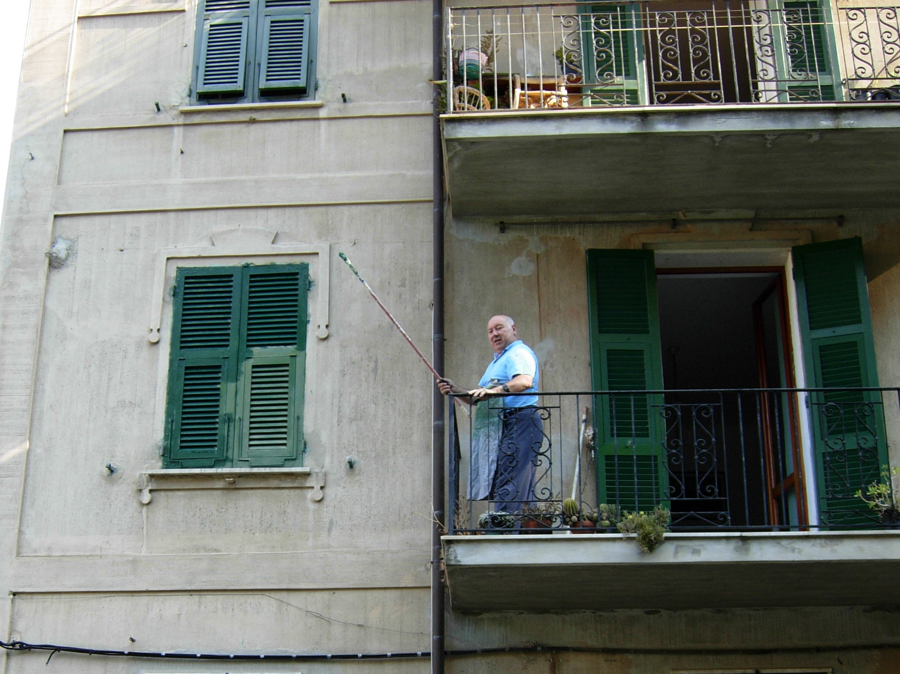
Who is this Shutter-Painting Fellow?
Create this “character.”
Who is he? Name, location, occupation, family, purpose, one discriminating feature.
Hit all five senses

Slide 22
On how to choose and use language
Everyday language is a good idea, because readers can quickly grasp your ideas. But when you use only everyday language, your content doesn’t stand out. You sound like everyone else. Your content lacks sparkle.
Writing is different from talking. When we speak we use hand gestures and facial expressions to add emotion and meaning to our words. But when we write, we can’t wink, we can’t smile, we can’t slam the table, and we can’t put our hands up in the air.
So, our written words have to work harder. Our words have to whisper or shout. Our words have to attract attention and engage. Our words have to express emotion.
This is why you need to infuse your writing with more emotional words, with colorful language, with a sensory touch. You need to push yourself gently outside your comfort zone and play with different words.

