Slide 1
Week 2
Metaphors and Identities
Travel Writing
Lesley Klenk, Ph.D.
South Sound Senior Services
Spring 2020

Slide 2
Today’s focus: metaphors and identities
Update and comments on critiquing writing samples (I loved it!)
Discussion of Raban’s A Sea and Its Meanings”
Discussion of Freya Stark “East is West” (and other examples)
Metaphor as identity
Identity feeds stylistic devices, word choice, sentence length, formatting, transitions
Return to sensory details with new eyes
Creating gaps in travel writing so the reader tumbles and falls—in a magical way

Slide 3
Why do writers write?
People write because they have to or else they would burst…
Travel writers have a particular kind of urgency…they want readers to see what they saw.
Fiction writers are committed to themes, characters, plots, details—and even location (they call it setting).
For travel writers, location comes first—and it comes alive with the people (characters), events (plot), description (details).
Theme is the common denominator between fiction and travel writing, because we reveal the location through our eyes, our experiences, our values.

Slide 4
Travel writing is not trespassing on someone else’s property. You own this corner of the world.

Slide 5
Raban: “On the Sea and its Meaning”
Reactions?
Did you find where he ruptured the text and revealed his need for escape, freedom and solitude?
Or, did you find something else?

Slide 6
Breaking Raban down…
His writing is surgeon-like. Nothing is by chance. He is not sloppy. He is careful and works on a reader below the surface.
The searching deckhand starts and ends the narrative. Why?
He describes derelict boats and shiny new ones. Why the contrast?
Did his writing remind you of anyone else’s writing?

Slide 7
New York Times Book Reviewer says:
As a reader you'll want to know what kind of companion Raban might make, just who it is that's taking you for a ride. He seems to me rather saturnine, but also generous; restless, bookish, but nevertheless practical, someone who tends to stand a bit off the center of the scenes he describes.
Halfway through ''Passage to Juneau'' he makes a major digression: he flies to England to watch his father die. That, however, proves to be only the start of his troubles, and of the book's disclosure of this journey's ''true meaning.''

Slide 8
Sensory Details in Travel Writing
VISUAL describes colors, shape, appearance. Use “meaty words” for best impact.
TOUCH describe textures. Use words to describe feelings and abstract concepts.
AUDITORY describe sounds. Use onomatopoeic words that mimic the object itself.
TASTE describes emotions. Use words to show bitter, fear, sweet, salty
SMELL describe memories. Use words to elicit multi-layered meanings
MOTION describes activity. Use words to create a sense of movement in the text.

Slide 9
The master of detail
The resinous, linseed-oily smell of varnish and wet paint hung thickly in the still air of the terminal, and there was the continuous happy racket of electric saws and sanders, hammers, drills, and roaring blowtorches. Diesel engines were being hastily disemboweled, their black innards laid out, part by part, on afterdecks, while their bloody-knuckled owners muttered to themselves as they puzzled over camshafts and clearances. Pickup trucks, laden to the gunwales, were drawn up alongside those boats that were now most nearly ready to leave, and wholesale boxes of Dinty Moore stew and Campbell soup and plastic-wrapped bales of toilet tissue were being swung aboard on hoists. On the broad plaza of the net-mending area, a man and a woman were threading white, cigar-shaped floats at two-foot intervals along the top of their quarter-mile gill net. The jade-green, gossamer nylon mesh shimmered at their feet like a river.

Slide 10
To travel is a verb—it is movement, a journey, a story ever evolving.
He stank of the road — of hitchhiking on interstates, diving in Dumpsters, spending nights in cardboard boxes under highway bridges, gargling with Thunderbird.
-Jonathan Raban “A Sea and Its Meanings”

Slide 11
Freya Stark, what an amazing:
  woman
  writer
  Traveler
  explorer

Slide 12
Freya Stark
"The beckoning counts, not the clicking latch behind you.“

Slide 13
Freya Stark on the sparseness of details that speak volumes
—“Their beauty was in the bare torso, the muscles rippling in freedom under a skin to which a perpetual treatment of indigo, sun and oil gives a bloom neither brown nor blue, but something like a dark plum”
Even under their veils and heavy drapes, “no one in all that busy moving world wore either shoes or corsets; and it was this, I concluded, which gave them that grace and swallow-like motion.”

Slide 14
Freya Stark on wandering…
"This is a great moment, when you see, however distant, the goal of your wandering. The thing which has been living in your imagination suddenly become part of the tangible world. It matters not how many ranges, rivers or parching dusty ways may lie between you; it is yours now for ever."

Slide 15
Is Stark speaking the truth?
“The great and almost only comfort about being a woman is that one can always pretend to be more stupid than one is and no one is surprised.”
“A passion for mystery chiefly which explains the optimism of human beings toward both polygamy and travel.”

Slide 16
What is Freya Stark’s metaphorical identity as a travel writer?
“There is a cheerful quality in the neat brisk sound of trotting donkey feet on hard ground. And it is pleasant too, to sit on a donkey pack, when you know how to do it, without rigidity, meeting the jolts and caprices of your companion with an elastic temper and a capacity for balance; riding, in fact, as one rides through life, with a calm eye for accidents and a taste for enjoyment in the meantime.”

Slide 17
Stark’s Metaphor as a Travel Writer
“A finely calibrated compass with constantly searching needle”

Slide 18
An example of my own writing…for the purpose of transparency and investment
“Ghosts Who are Us” published on the blog, Travels with Paul, in October 2017.

Slide 19
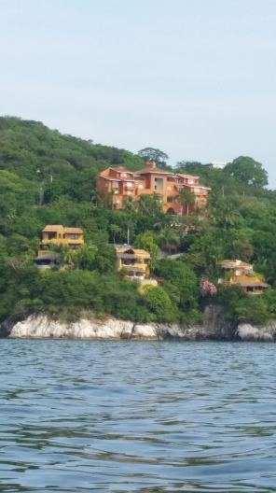
Greeting the Ghosts Who are Us
Paul and I are headed for Zihuatanejo, Mexico, the little beach town made famous in the movie (and book) Shawshank Redemption. Andy Dufresne escapes from prison and says to his friend Red Redding, “Get busy living or get busy dying.”
Paul and I are busy living.
We traveled to the humble town of Zihuatanejo in 2015 and fell in love with it. We could go to the sleek high-rise hotels of Ixtaa a few miles away, but there is something about Zihuatanejo that calls us back. We love it for its grubby, funny, sweet places and people. I hope, like last time, that as soon as our taxi leaves the highway and begins bumping along the pot-holed streets, the children in their school uniforms will run along next to us smiling and waving through the window.
.

Slide 20
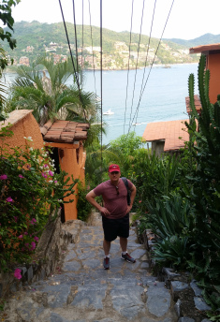
Greeting the Ghosts Who are Us, cont.
The quaint, raspberry pink-hued hotel, Paseo de Morro, is our very own Grand Marigold Hotel from the movie by the same name. It clutches the rocks on the side of the cliff hanging over Zihuatanejo Bay. It is not uncommon to see yard boys chase scorpions down the stairs while the sweet girls who work at the reception desk place geckos on their shoulders and pet them with shy smiles.
There are 166 steps from our hotel into town. A few times we started the margaritas earlier than was advisable, and the climb back to the top was demoralizing. The hotel staff who call us Mr. Paul and Miss Lesley clucked like disapproving mother hens when we appeared in the lobby tired, hot, and, let’s just say it—intoxicated.

Slide 21
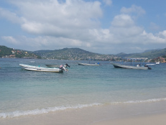
Greeting the Ghosts Who are Us, cont.
I have prepared myself that the magic of “first times” will be fewer. However, I will go down the steps and stand on the shore with the arrival of the first ray of sunrise when the long and fast panga boats hurtle towards the familiar landmarks that welcome them home each morning. The fishermen who cast their nets by the light of the moon or by headlamps on moonless nights, slide their shallow-bottomed boats onto the beach and push their bounty over the side. Fish, some still flopping, rain onto the sand and wait for the restaurants from the resort town to come and select the catch of the day. No matter how many times I see that flotilla heading for shore, I know my breath will catch in my throat just a little.

Slide 22
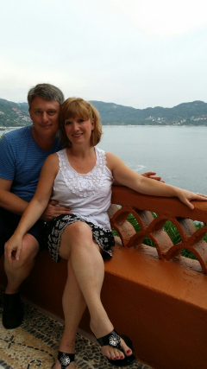
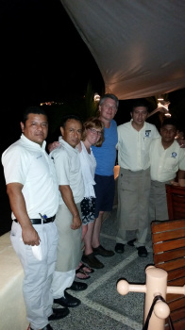
Greeting the Ghosts Who are Us, cont.
We hope that time has stood still in a few places most notably our favorite restaurant, Bistro Del Mar, a hole-in-the-wall eatery we discovered by trailing on the heels of a visibly well-fed family and lifting our noses to the delectable smells of meat cooking over a fire and beans, laced with fat, bubbling on a stove top.
To return to where you have been, to be young where you were once younger, to expect the unexpected all the while knowing full well what to expect—it is a rather odd place to be in the universe. If anything, those two ghosts of our past—the younger Paul and Lesley—better at least push us up the stairs or we won’t tell them how much more wonderful their lives get in the future.

Slide 23
Let’s get to those metaphorical identities…

Slide 24
Why a Metaphor and Not a Simile?
You are the metaphor! You take on the characteristics, the drive, the reflection, the vision, and purpose
A simile is only “like” or “as” something else. You want to own your writing identity.

Slide 25
Identity Metaphor
as a Travel Writer
Names | Metaphor | Stylistic Devices | Voice | Themes | Purpose
Lesley | On a Train Leaving Paris | Focus on events, humor, dialogue for conflict and characterization, images that connote caring | Maternal, reflective, reactive, internal and external | Returning, embracing, remembering youth | To share my favorite places and why

Slide 26
Creating Purposeful Gaps to bridge parts of your writing
Looking Back
Looking forward
Losing things is about the familiar falling away, getting lost is about the unfamiliar appearing. There are objects and people that disappear from your sight or knowledge or possession; you lose a bracelet, a friend, the key. You still know where you are. Everything is familiar except that there is one item less, one missing element.
Looking forward you constantly acquire moments of arrival, moments of realization, moments of discovery. The wind blows your hair back and you are greeted by what you have never seen before. The material falls away in onrushing experience. It peels off like skin from a molting snake.

Slide 27
Writing Prompt
Carson McCullers, author of The Heart is a Lonely Hunter, says, "As often as not we are homesick most for the places we've never been." Do you have a longing for a place you've never visited?

Slide 28
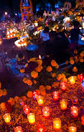
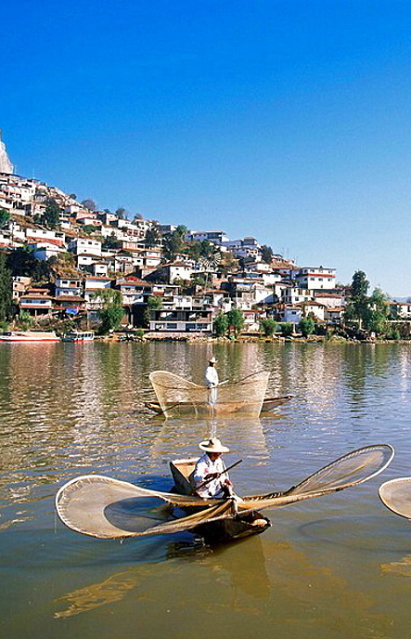
Hill Towns of Central Mexico
Morelia, famous for its Day of the Dead celebrations and Monarch Butterfly arrivals
Patzcuaro, artist colonies and fisherman with butterfly-like nets

Slide 29
Assignment: figure out what your metaphorical identity does as a writer
Word choice—academic, everyday, common, fanciful, etc. Revise with those new eyes
Add more compelling sentences to the ones you have already.
Consciously insert a sensory detail (or change a current non-sensory detail)for each of the five +motion senses.
Ask yourself—what is my purpose for writing this travel piece? Are you going to accomplish your goal?
Are my readers going to tumble into my hollow of meaning somewhere? Where?

Slide 30
Who are Travel Writers?
Travel writers use a single genre or a mix of genres in constructing their travel writing, but they must have a reason, a compulsion, a desire, a need to write first about a place and second from a perspective.
Use a metaphor to describe your travel writing identify. Are you:
  A oxen yoked to a plow in an endless field
  A night moth creating the slightest of shadows
  A lump of bread dough kneaded until it is finally ready
  See the next slide for more options

Slide 31
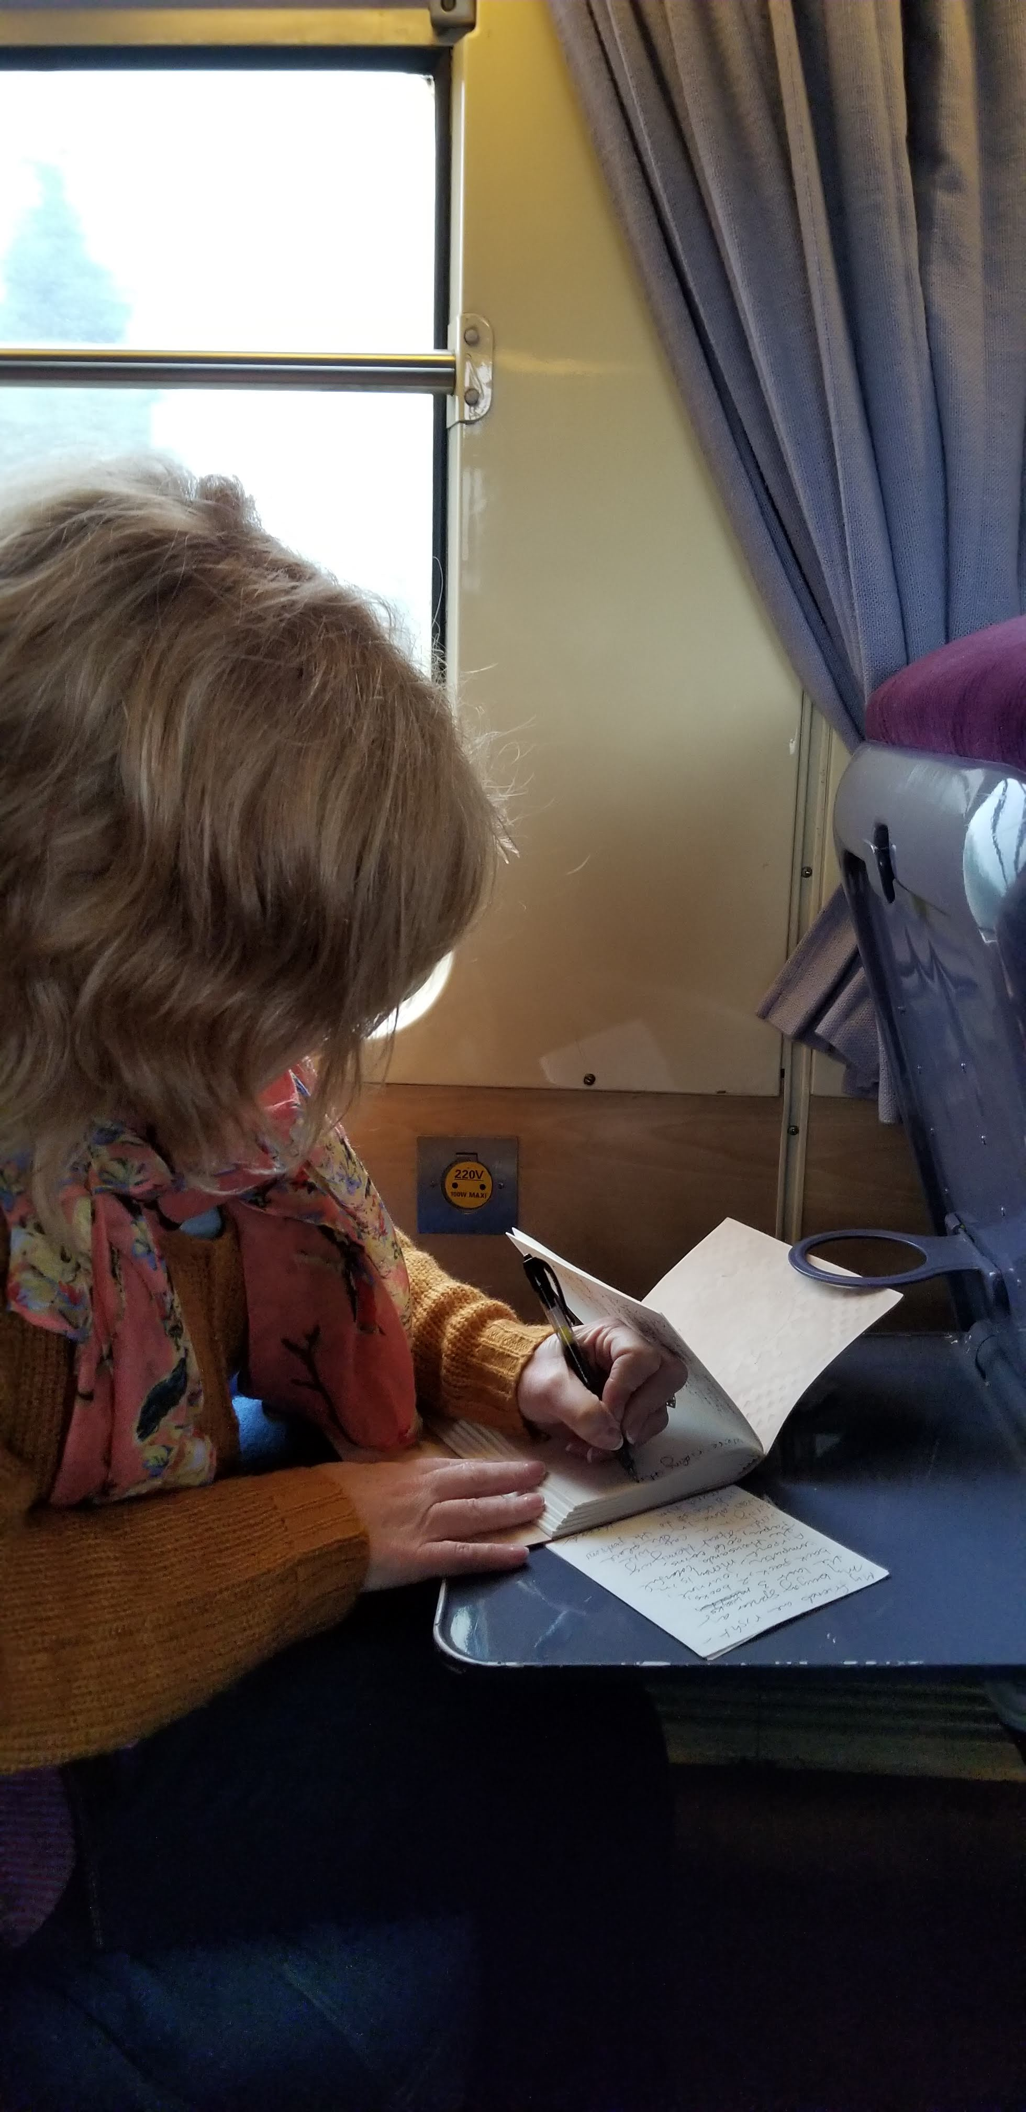
Who are you as a travel writer? What object or experience best describes your identity?
What is it? A tombstone, a beating bloody heart, a butterfly emerging from a cocoon, a baby newly born, a mouse sidestepping the people in the house unobserved, a falling fall leaf brilliant in the sunlight yet about to drop to the ground with the lifeless others, a tire rolled off the edge of the canyon, a ghost,
I am… a Train Leaving Paris

Slide 32
Assignment: Insert dialogue into your travel essay/memoir/narrative
Good dialogue:
Reveals conflict, struggles to explain, misinterpretations
GIVE THE CHARACTERS CONFLICTING GOALS, shows they come from different perspectives,
SHOULD BE THERE FOR A REASON, such as driving the piece of writing forward
DEEPENs CHARACTERIZATION and gives the writer a break from description

