Slide 1
Week 6: travel writing transitions, Author biographies, and Back cover reviews
Lesley Klenk, Ph.D.
South Sound Senior Services
Spring 2020

Slide 2
Topics for today’s class: transitions, author biographies, and back cover reviews
Transitions are like skiing down a mountain—shish, shish—the cuts your skis makes with the movement of your knees and poles should be silent but look effortless.
The best transitions are the ones a reader does not notice.
Every writer should have an author biography in her back pocket. On the occasion you are asked to read for a group, the person who introduces you will read your biography to the audience.
When your writing is published, an author biography precedes your work and creates a window from which the reader will peer through.
Back cover reviews show that the writer has a network of colleagues who know and appreciate her work; they entice new groups of readers to take chances on an unknown genre; they are perhaps one of the few times an author feels like a star.

Slide 3
Transitions…definition
Transitions are words or phrases that carry the reader from one idea to the next. They help a reader see the connection or relationship between ideas and, just as important, transitions also prevent sudden, jarring mental leaps between sentences and paragraphs

Slide 4
Transitions in the essay
Transitions between sections: Particularly in longer works, it may be necessary to include transitional paragraphs that summarize for the reader the information just covered and specify the relevance of this information to the discussion in the following section.
Transitions between paragraphs: If you have done a good job of arranging paragraphs so that the content of one leads logically to the next, the transition will highlight a relationship that already exists by summarizing the previous paragraph and suggesting something of the content of the paragraph that follows. A transition between paragraphs can be a word or two (however, for example, similarly), a phrase, or a sentence. Transitions can be at the end of the first paragraph, at the beginning of the second paragraph, or in both places.
Transitions within paragraphs: As with transitions between sections and paragraphs, transitions within paragraphs act as cues by helping readers to anticipate what is coming before they read it. Within paragraphs, transitions tend to be single words or short phrases.

Slide 5
LOGICAL RELATIONSHIP | TRANSITIONAL EXPRESSION
Similarity | also, in the same way, just as … so too, likewise, similarly
Exception/Contrast | but, however, in spite of, on the one hand … on the other hand, nevertheless, nonetheless, notwithstanding, in contrast, on the contrary, still, yet
Sequence/Order | first, second, third, … next, then, finally
Time | after, afterward, at last, before, currently, during, earlier, immediately, later, meanwhile, now, recently, simultaneously, subsequently, then
Example | for example, for instance, namely, specifically, to illustrate
Emphasis | even, indeed, in fact, of course, truly
Place/Position | above, adjacent, below, beyond, here, in front, in back, nearby, there
Cause and Effect | accordingly, consequently, hence, so, therefore, thus
Additional Support or Evidence | additionally, again, also, and, as well, besides, equally important, further, furthermore, in addition, moreover, then
Conclusion/Summary | finally, in a word, in brief, briefly, in conclusion, in the end, in the final analysis, on the whole, thus, to conclude, to summarize, in sum, to sum up, in summary

Slide 6
Transition: Location, Comparison, Contrast
Location: above, across, outside, near, beyond, beneath, beside.
Comparison: just as, likewise, just like, similar to, in the same way.
Contrast: but, however, even so, on the other hand, otherwise, still.

Slide 7
Punctuation Device for Meaning | What it indicates to the reader
Ellipses | Ellipses are used when the author trails off unable to complete the thought…purposefully
Parentheses | Parentheses are used to speak intimately to the reader about (a smaller idea within the bigger idea)
Asking Questions | Asking questions shows intellectual curiosity and broadening the topic
Bold Text | Using bold text to say listen to me! This is important!
Italics | Incorporating italics indicates sustained and internal talk from the author to the reader
Long sentences | Using long sentences indicates the author is going to tell the reader about both event and meaning
Short Sentences | Using short sentences indicate either event or meaning usually implied.
Semicolons | Semicolons connect two sentences too close to separate
Colons | Semicolons connect two sentences too close to separate Colons are the “are you ready for this?” Like holding a breath before a list.
M-dash | M-dash is used to set apart information in the middle of the text and draw attention to it. It’s like a discovery.
Asterix | Asterix is the small star above the 8 key. Use it as a more obvious transition between sections.

Slide 8
How to write an author biography
Lead with your name in third person
Combine a former job or role with your new title “travel writer”
Give an overview of your travels
Select one place that “stands out” to you (probably your forever essay)
Mention taking the class
Plans for the future—traveling, reading about a special place, writing memoir for family.
Aim for 100-200 words

Slide 9
Statements to avoid in your author biography
Avoid:
  “found her passion”
  “follows her dreams”
  “lives the best life”
  “spends her time”

Slide 10
Sample Author Biography…
Lesley Klenk, PhD, a published writer, blogger, and teacher of travel writing, has made her home primarily in Washington state with a few stints in the Northeast and the Heartland while earning advanced degrees in English. Her writing meanders through the genres of literary fiction, travelogue, memoir, and creative non-fiction. You can read her work on her travel blog, Travels with Paul, the social media platforms Thurston Talk, Grays Harbor Talk, and the online magazine, Living Better After 50. Klenk realized her calling as a travel writer after escaping a locked bathroom stall in Mexico, surviving a close encounter with a shrieking hyena in South Africa, and stumbling into an illicit speakeasy in Paris. Her mission is to laugh her way around the world even if she does have to fly economy class.
133 words

Slide 11
Template for Author Biography
(Start with name) a (insert former title, vocation, etc) lives in (insert neighborhood, city, state) (or you can say formerly lived in, etc.). Her interests include: (list writing, history, education, etc.) Her travel writing is inspired by her trips to (insert all trips), but her journey to (insert place of essay) helped her (insert understanding of, realization to, etc.). Following the author’s participation in the travel writing class, she now plans to (insert write, travel, memoirs, research, etc). (insert a funny or moving statement about the power of travel to end biography)

Slide 12
How to write back cover reviews
Back cover reviews are short statements by other authors and reviewers praising the work. They can be:
  Other experts in the same field who confirm truth of the text’s interpretation
  Named publications that validate the quality of the work
  An author from a different genre who has a big readership.

Slide 13
Keys to writing back cover reviews
  Keep the writing tight. ...2-3 sentences maximum (I did not follow this rule at all. See your back cover reviews on the final slides)
  Put in a hook for the reader—a sneak peak, an alluring idea (including perhaps a play on words that alludes to the title or topic)
  Grab the reader with bright, bold descriptive words
  Leave the reader with a sense of anticipation
  Types of back cover reviews include: overview of the larger topic or conflict; comparison to another work; description of stylistic devices used by the author, summary of the text, etc.

Slide 14
Examples of back cover reviews
“Jim Lynch is an extraordinary writer. … In `Before the Wind’ he captures the essence of it all. … A story of family, fortune and change that critics have justly compared to Ken Kesey’s classic `Sometimes a Great Notion.” – The Florida Times Union (comparison to another work)
"From the first paragraph I was hooked by Jim Lynch's language, his humor, his wisdom. The characters are marvelous, the storytelling confident and rollicking; the whole book a delight and a surprise." --Maria Semple, "Where'd You Go, Bernadette?“ (description of stylistic devices)
"Not just any writer could weave a story about sailing, speed dating, dysfunctional family dynamics and Albert Einstein into an emotionally resonant novel, but Jim Lynch is the man for it." -- The Seattle Times (summary)
“Lynch writes about the science of sailing and the grandeur of Puget Sound with a Melville-like attention to detail, but in the very concreteness of those details a kind of poetry emerges that speaks of the transience of life in all its terrible beauty and exhilarating terror.” —Booklist (larger context or topic)

Slide 15
Template for writing a comparison to another author back cover review
Example: “Jim Lynch is an extraordinary writer. … In `Before the Wind’ he captures the essence of it all. … A story of family, fortune and change that critics have justly compared to Ken Kesey’s classic `Sometimes a Great Notion.” – The Florida Times Union (comparison to another work)
Template: (Insert name of author) is a (insert positive adjective) writer. In (insert title of essay), he/she demonstrates mastery of (insert an overarching theme of the essay). It is a story of (insert a list of three compelling ideas from the essay) Readers say that (insert name of essay) hearkens back to (insert appropriate author and title of book/essay similar to this book/essay) in its (choose appropriate term or come up with your own style, voice, tone, use of sensory detail) to show the value of (insert a conclusion).

Slide 16
Template for writing a description of stylistic devices back cover review
Example: "From the first paragraph I was hooked by Jim Lynch's language, his humor, his wisdom. The characters are marvelous, the storytelling confident and rollicking; the whole book a delight and a surprise." --Maria Semple, "Where'd You Go, Bernadette?“ (description of stylistic devices)
Template: From the first (insert sentence/line/paragraph), I was (insert verb similar to “hooked”) by (insert author’s name)’s (insert one or more stylistic devices). The (insert description of characters/plot/style). The whole book/essay is a (insert one or more adjective).

Slide 17
Template for writing a summary back cover review
"Not just any writer could weave a story about sailing, speed dating, dysfunctional family dynamics and Albert Einstein into an emotionally resonant novel, but Jim Lynch is the man for it." -- The Seattle Times (summary)
Not just any writer could (insert weave, develop, create, etc.) about (insert three main ideas of the essay/book that summarizes the main events) into a (insert thematic idea), but (insert author’s name) is (insert strong statement about the character of the writer.)

Slide 18
Template for writing a larger context or topic back cover review
Example: “Lynch writes about the science of sailing and the grandeur of Puget Sound with a Melville-like attention to detail, but in the very concreteness of those details a kind of poetry emerges that speaks of the transience of life in all its terrible beauty and exhilarating terror.” —Booklist (larger context or topic)
Template: (insert name of author) writes about the (insert two large ideas that are similar to ‘book ends’ for the book/essay) with a (insert a statement that alludes to well-known author and their signature style), but in the (insert sweeping statement connecting the book/essay to a universal theme).

Slide 19
Big picture back cover book reviews for models
"An affectionate and very funny tribute to the gentle madness of sailing diehards." - The Wall Street Journal
"A brilliantly crafted family story ... An exhilarating read." - The Washington Times
“This is an incredibly robust evocation of the sailing world of Puget Sound.” –The New York Times Book Review
“A veritable feast for the senses. ... Before the Wind can’t help but leave you enthralled, inspired and thirsty for more.” –The Huffington Post

Slide 20
We’ve come a long way—here are your back cover reviews!

Slide 21
Back cover review for “Ships in the Desert”
“In her essay, “Ships in the Desert,” Barbara Lind slips effortlessly through the portals of her travels in Tunisia and the ancient history of the region using thoughtful, precise language. She tenderly describes a journey with her husband and son on the backs of camels making their way through shifting sands while also capturing the bereft silence of a desolate Roman Forum surrounded by crumbling, soaring columns, Lind’s final vision is of local women clothed in their black Hajibs bunched on the side of the dusty road cooking their family’s meals. It is a poignant moment—an intersection of modern life and a continued past—and reveals a writer with an attuned hand of deftness who can tell a story like a moth that casts shadows both in the day and the night with a persistent reminder to remember the link between history now and in the past.
                Lesley Klenk, Author, “I’ll Do it My Way with the Help of Twenty Dancing Thai Women”

Slide 22
Back Cover Review for “New Guinea Pages”
In her essay, “New Guinea Pages,” author Lois Ware is anything but an ordinary yellow pencil telling the story of an adventurous trip to New Guinea that, in some ways, helped define her future course in life. Ware courageously uses sophisticated stylistic devices to tell her story including internal point of view, humor, foreshadowing, descriptive fragments as slides contained in the old carousels, and individual stories that work seamlessly as a whole tale. Ware’s development of her accompanying character is careful, controlled, and artful. The reader does not need to know the story beyond the conclusion, for it is evident through her voice and selection of events that the journey started and ended with more than just flight. Ware’s triumph over thumping flying foxes, an unfamiliar culture, and a life-defining event on a treacherous road, shows that, as a writer, Ware has an ear for the subtle, an eye for the indirect, and voice that speaks the truth.
              Lesley Klenk, Author, “I’ll Do it My Way with the Help of Twenty Dancing Thai Women”

Slide 23
Back Cover Review for “Negotiations with Self and Others while Traveling in India”
Sara Rucker Thiessen’s essay, “Negotiations with Self and Others while Traveling in India,” engages the reader immediately with her entertaining voice that holds multiple ideas and streams of conversation. She layers details upon details to bring her journey to life---preparing for her trip, reflecting on the group members, remaining flexible about the unreliable transportation and accommodations, and embracing the chaos and beauty of India. The author’s use of sensory description causes color to burst from the page especially in her descriptions of the fresh food, lush landscape, and screeching, birds and animals. However, it is the author’s direct communication with the reader through the stylistic device of asking questions that causes one to scoot forward and pull the text closer. The author quietly reveals the core of her marriage—negotiations—and queries the reader for insight. It is a strategic and whole-hearted style that makes the reader search her life for her own negotiations. In the final part of the journey, the author finds the shala, a home, and blithely embraces other identities: the actor, the yogi, and the court jester juggling her life. It is a beautiful, transformative moment—the reader understands the power of negotiating with one’s self and others.
–Lesley Klenk, Author of “I’ll Do it My Way with the Help of Twenty Dancing Thai Ladies”

Slide 24
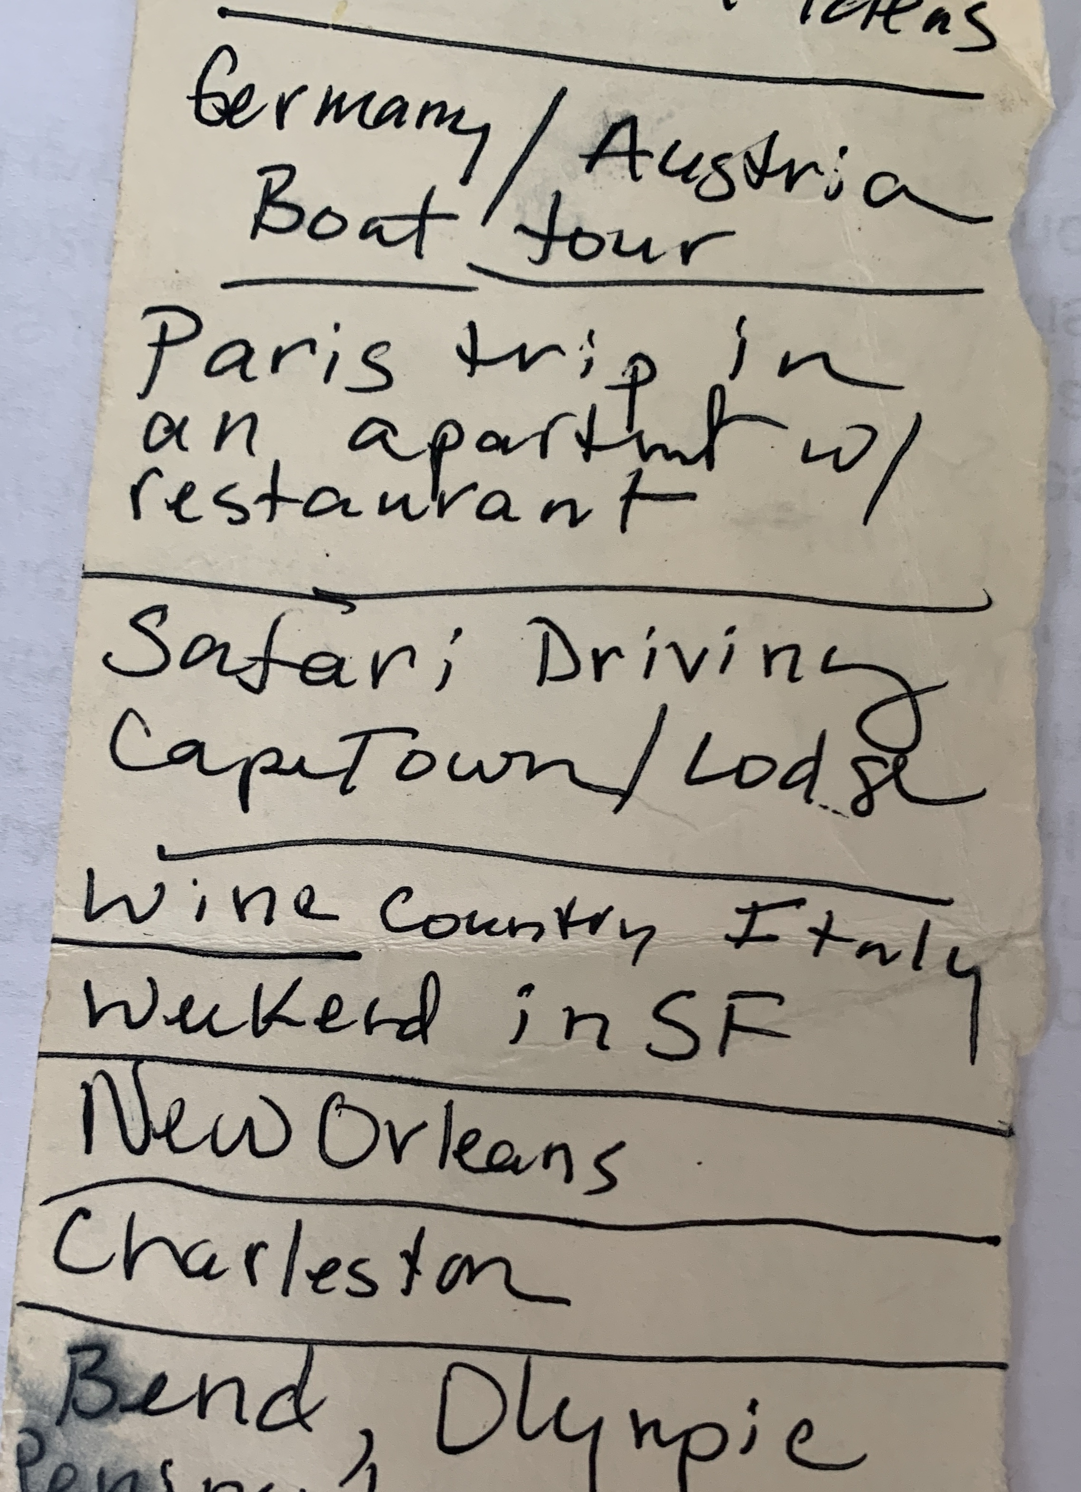
Dream vacation list from 5 years ago…I wrote it on the back of a check register sitting at the doctor’s office…where is your list?

